Slide 1

A Case Study of a RAG+MCP LLM System (Happy New Year special session)
Dr Hongqing Yu (Harry)
Associate Professor in data science
University of Derby

Slide 2
Aim of the session
To introduce the real application developed for Bolsover District Council
To learn RAG system development and the MCP (Model Context Protocol) concept
Further discussions on LoRA for Fine-Tuning LLMs (student class presentation slides by Jiaqi Song, Xianwei Zou, Hanshi Sun and Steven Kolawole, 2024)

Slide 3
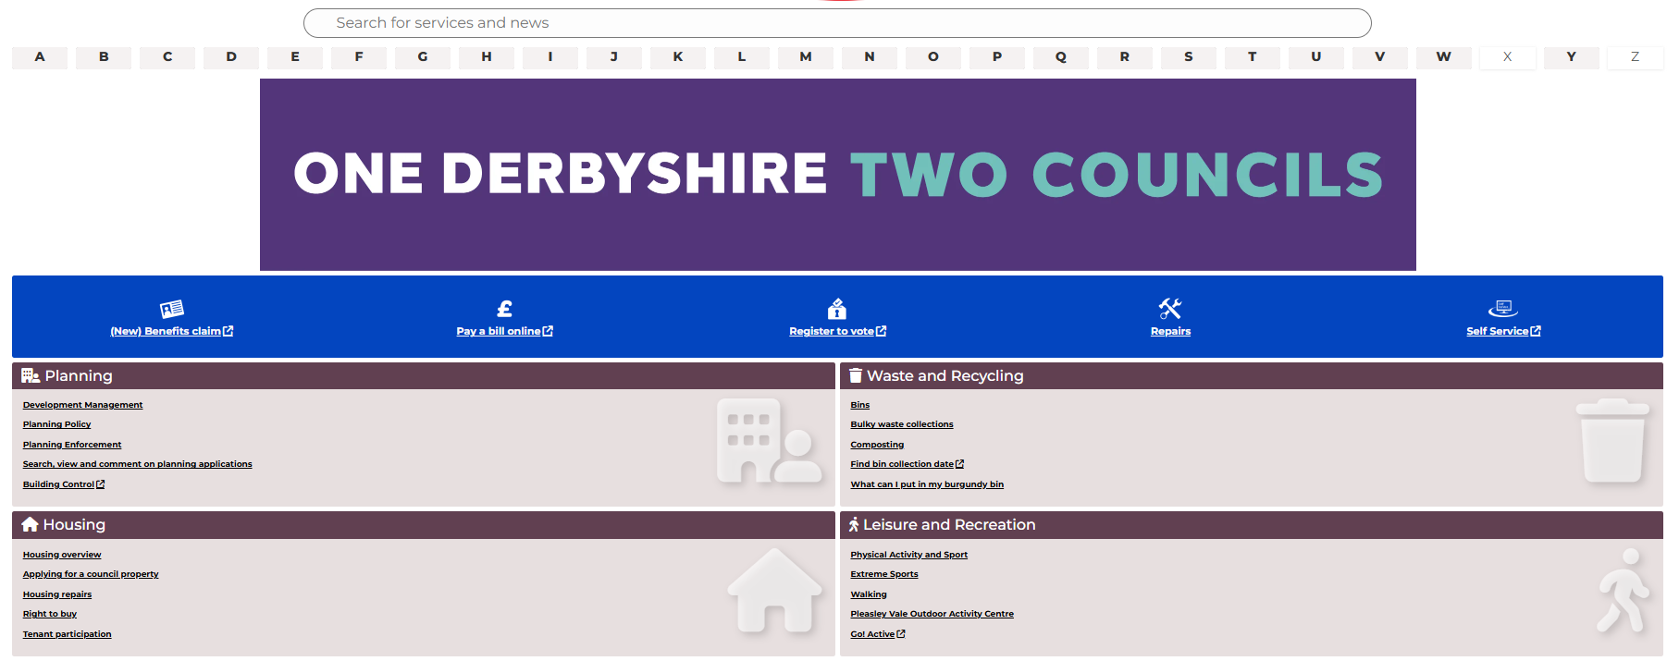
Bolsover District Council Story
Badly organised information and human-centric Q&A phone-call services

Slide 4
Can AI support searching and answering complex questions from citizens?
Is the council ready? Home
What technology do we need to provide the solution? Trustworthy, Evidenced, Thinking process
Cost?
No

Slide 5
Unique AI Framework
Data Sources
AI Interface
MCP client Agent
Reasoning Logic
MCP servers
Business Logic
operations
Data storage
Front-end Container
Middle Layer Container
Backend Container

Slide 6
Chatbot system
Data Sources
AI Interface
MCP client Agent
Business Logic
operations
Data storage
MCP servers (MS)
Front-end Container
Middle Layer Container
Backend Container
1. Connecting to the data
2. Indexing and vectorising the data
3. Searching for data related to the query
MS
Environmental Health
MS
Recycling
MS
Planning
MS
Social Care
MS
Housing
MS
Leisure

Slide 7
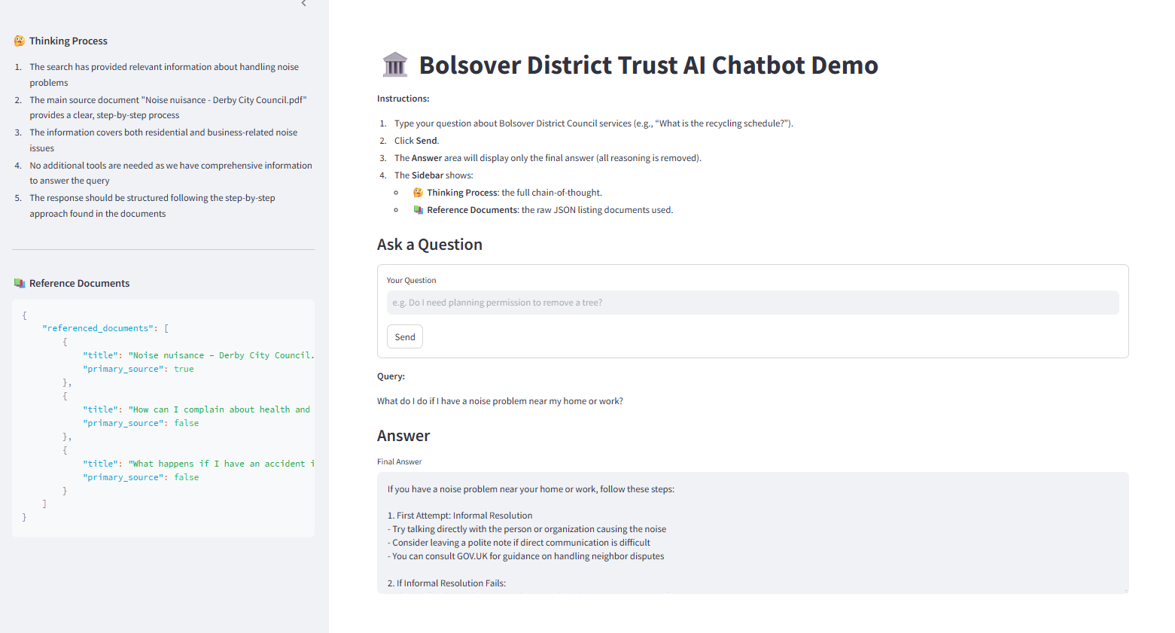

Slide 8
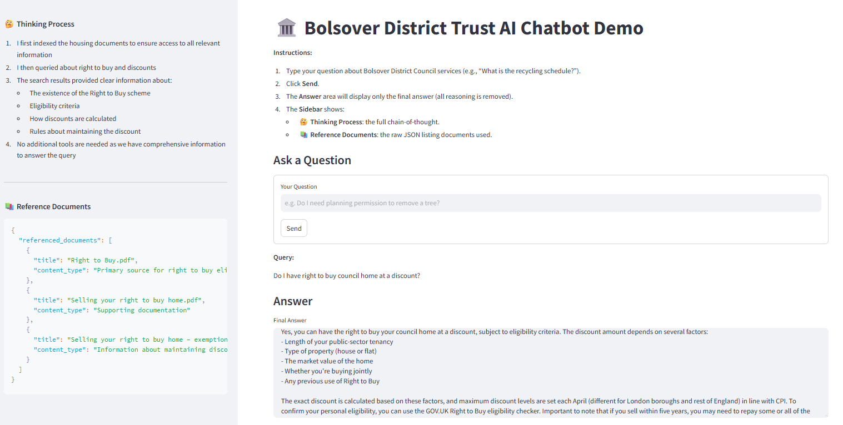

Slide 9
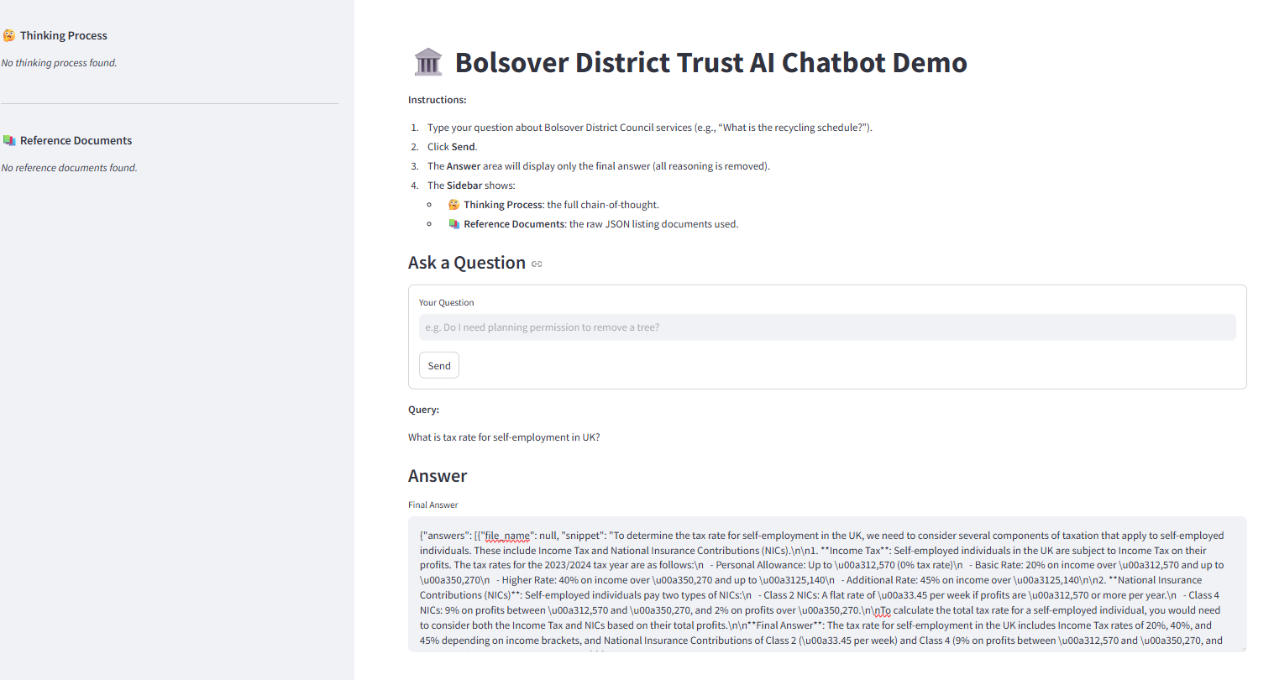

Slide 10
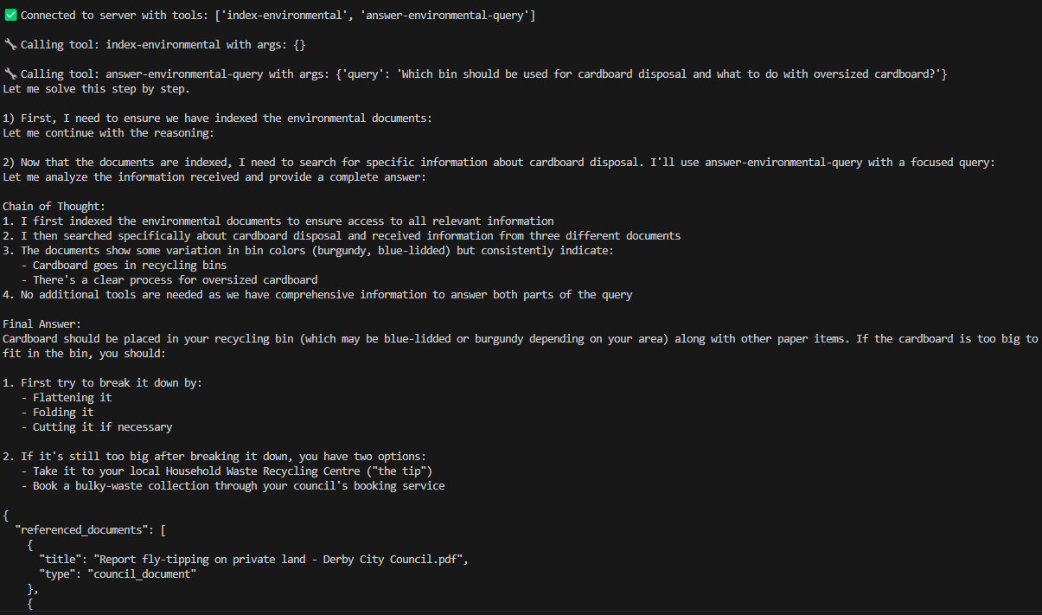
What the backend does
Which bin I should use for putting cardboard? If it is too big what should I do?

Slide 11
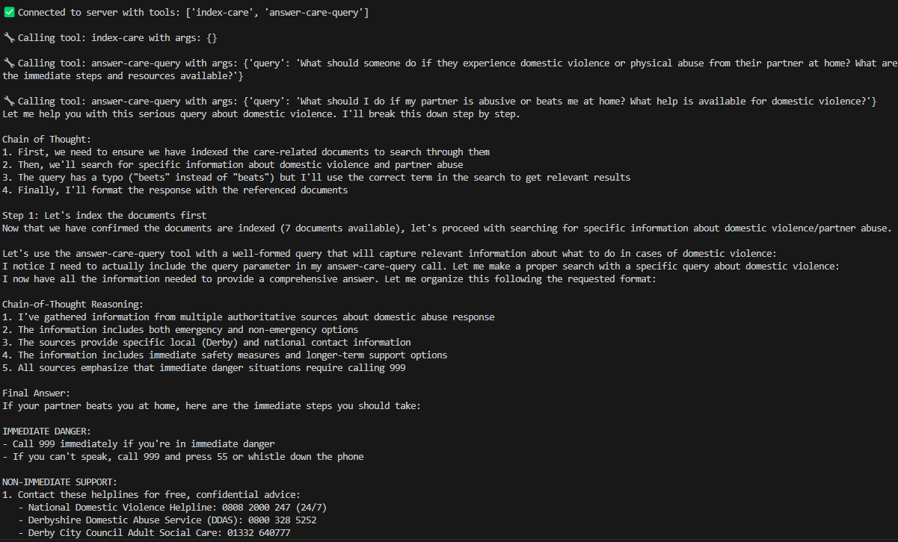
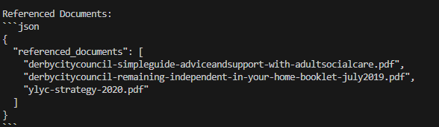
Another backend example
What should I do if my partner beets me at home?
Notes:
The typo ‘beets’ in the question is deliberate: the agent spots it and searches for ‘beats’.

Slide 12
At the code level
The code package is available in the Blackboard (BB) learning resources
Now we go deeper into the Python code together

Slide 13
LoRA for Fine-Tuning LLMs
Slides: “LoRA and QLoRA Fine-Tuning (Student Presentation 2024)” in 6 Further Reading on the course website

